Slide 1
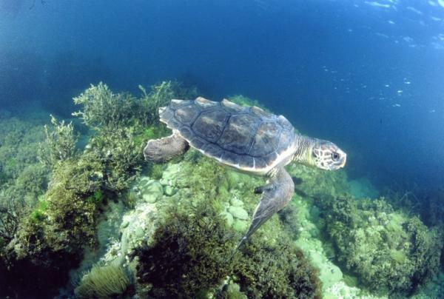
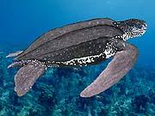
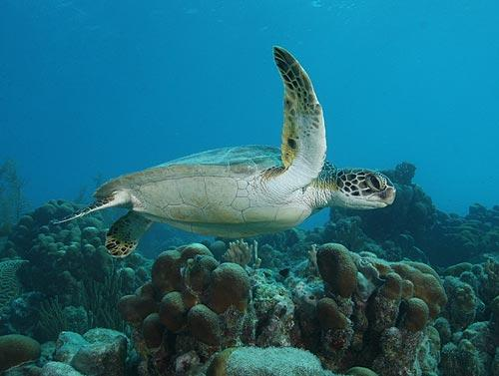
Endangered Sea Turtles of the Florida Keys
Loggerhead Turtle
These turtles are known to be the largest hard-shelled sea turtles. Their shells are a reddish brown color. They have massive heads with strong jaws.
Leatherback Turtle
These turtles are known to be the largest sea turtles in the world with an astonishing seven foot length and 2,000 pound weight. They are mostly recognized for their size and shells. Unlike most turtles, their shells are soft and somewhat rubbery; hence the name "leatherback".
Kemp's Ridley Turtle
These turtles are said to be the smallest sea turtles with the length of 24-28 inches and the weight of 100 pounds. Their shells have a nearly circular grayish-green top and a pale yellow bottom shell.

Slide 2
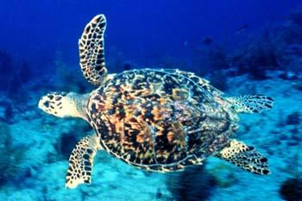
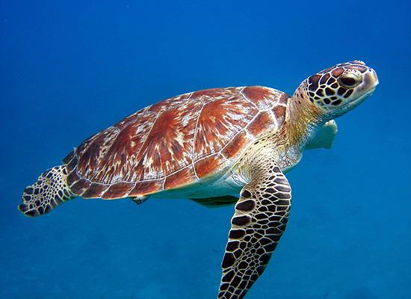
Hawksbill Turtle
This turtle is an average of two and a half feet long with an oval shell. The turtle has a small head with a distinct hawk-like beak. Their flippers have two claws. The coloring of the turtle is mostly brown with splashes of yellow, orange, reddish-brown, giving the creatures a colorful and recognizable shell.
Green Turtle
This turtle has a brownish shell, but it is the creature's light green skin that generates its name. The turtle has a heart shaped shell and a small head. The average length of the creature is five feet long with a weight of 700 pounds making it one of the biggest sea turtles in the world. The males are slightly larger than the females. Although the females have tails while the males do not.

